Slide 1
Unit 6
Solid Modeling

Slide 2
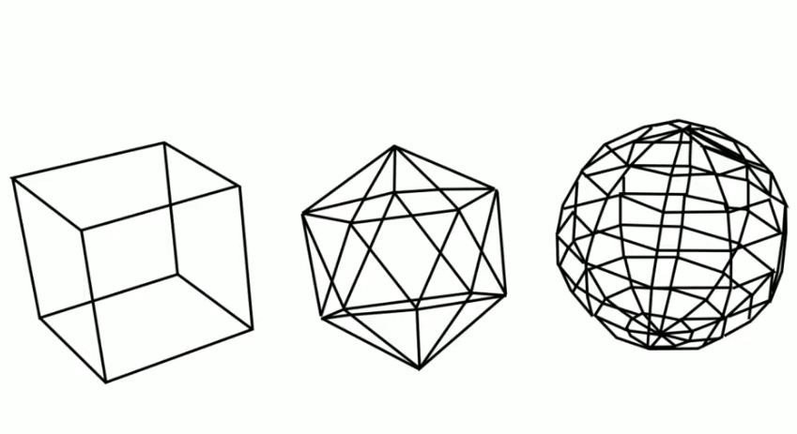
Solid modeling is a consistent set of principles for mathematical and computer modeling of three-dimensional shapes.
There are three types of 3D model:
Wireframe - Uses lines, arcs and curves as if the object shape were made with pieces of wire.

Slide 3
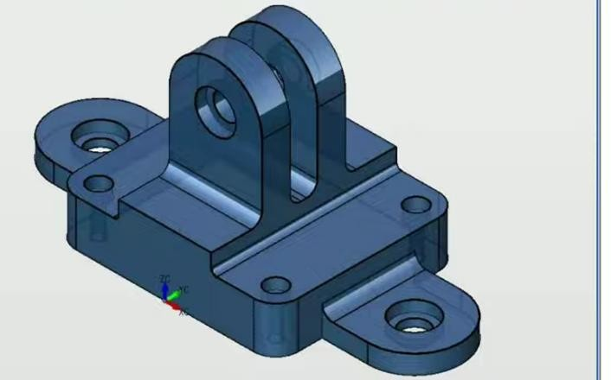
Surface - Uses surfaces to show the outside of the model, as if it were made from pieces of stretchy paper. It’s hollow inside, but looks realistic on the outside.
Solid - Uses solid material throughout, not hollow. Solid model of an object is a more complete representation than its surface (wireframe) model. It provides more topological information in addition to the geometrical information which helps to represent the solid unambiguously.

Slide 4
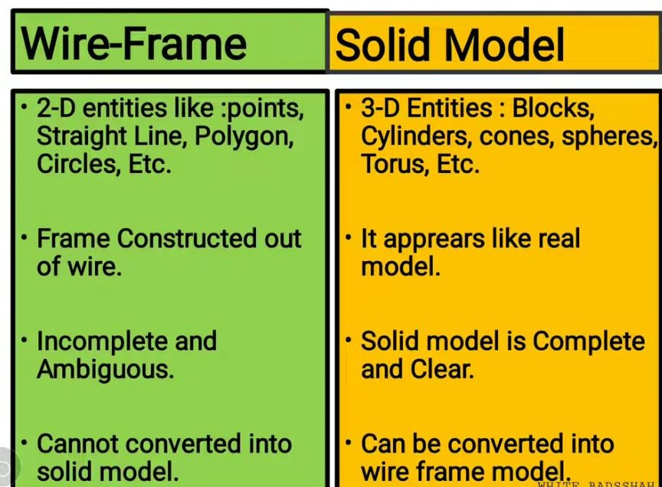

Slide 5
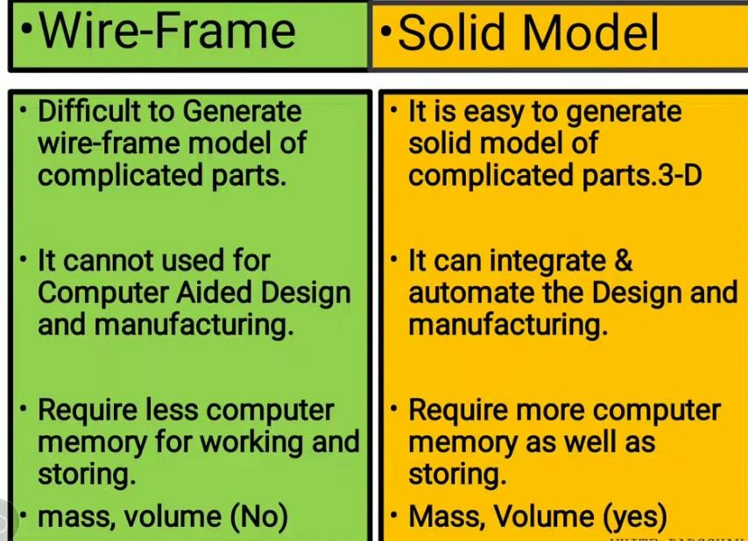

Slide 6
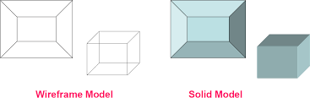
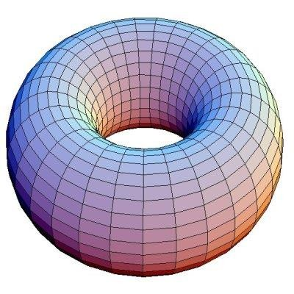

Slide 7
Geometry and topology:
Geometry: Metrics and dimensions of the solid object. Location of the object in a chosen coordinate system.
Topology: Combinational information like connectivity, associativity and neighborhood information. Invisible relationship information.
Solid Modeling
Solid modeling is a consistent set of principles for mathematical and computer modeling of three-dimensional solids.
A mathematical technique for representing solid objects.
An object with following specification is called solid: Vertices, edges, surfaces, weight and volume.
Solid modeling is based on complete, valid and unambiguous geometric representation of physical object.
Complete: points in space can be classified. (inside/outside).
Valid: Vertices, edges, faces are connected properly.
Unambiguous: there can be only one interpretation of object.

Slide 8
Advantages of solid Models
Unlike wireframe and surface representations which contain only geometrical data, the solid model uses topological information in addition to the geometrical information to represent the object unambiguously and completely.
Solid models results in accurate design, helps to further the goal of CAD/CAM like CIM.
Computer-aided design (CAD) and Computer-aided manufacturing(CAM). computer integrated manufacturing (CIM) is sometimes used interchangeably with CAM and CAD/CAM
Flexible manufacturing leading to better automation of the manufacturing process.

Slide 9
The common representations in solid modeling are:
Spatial Enumeration: In this simplest form of 3D volumetric raster model, a section of 3D space is described by a matrix of evenly spaced cubic volume elements called voxels.
Cell Decomposition: This is a hierarchical adaptation of spatial enumeration. 3D space is sub- divided into cells. Cells could be of different sizes. These simple cells are glued together to describe a solid object.
Boundary Representation: The solid is represented by its boundary which consists of a set of faces, a set of edges and a set of vertices as well as their topological relations.
Sweep Methods: In this technique a planar shape is moved along a curve. Translational sweep can be used to create prismatic objects and rotational sweep could be used for axisymmetric components.
Primitive Instancing: This modeling scheme provides a set of possible object shapes which are described by a set of parameters. Instances of object shape can be created by varying these parameters.
Constructive Solid Geometry (CSG): Primitive instances are combined using Boolean set operations to create complex objects

Slide 10
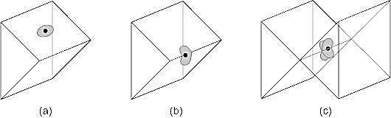
Major modeling schemes:
Boundary representation:
The solids are described by its boundary surface. Uses the description by vertices, edges and faces.
The most common representation is the boundary polygons.
Will be considered only with solid border 2-manifolds(wherever the point is each edge shared by two faces) i.e. the neighbors of any point of the border point are on a disk (that is to say that each edge is shared by two faces)
Figure(a) and (b) are 2-manifold (c) is not 2-manifold

Slide 11
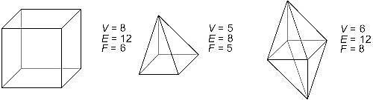
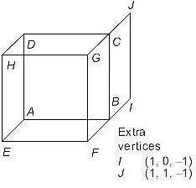
Polyhedron:
Solid delimited by a set of polygons whose edges belonging to two polygons (for solids 2- manifolds).
- Boundary representation for single polyhedron satisfy Euler’s formula V -E+F=2 where, V- vertex, E –edges & F- faces.
The Euler's formula is necessary but not sufficient to ensure that an object is a simple polyhedron.

Slide 12
Spatial Partitioning Representation:
A solid is represented as a collection of adjoining non-intersecting object.
For example: Octree
Sweep Representation:
Sweep representations create solid by moving a 2D shape (triangle, rectangle, polygon etc.) according to predefined rule (translating, rotating).
Sweep representations are used to construct 3D object from 2D shape that have some kind of
symmetry.
For example, a prism can be generated using a translational sweep and rotational sweeps can be used to create curved surfaces like an ellipsoid or a torus.
There are two types sweep representation:
Translational Sweep: A 2D shape is translated by a predefined translational vector. Example: following figure shows a translational sweep of rectangle. Steps:
Define a shape as a polygon vertex table as shown in figure (a).
Define a sweep path as a sequence of translation vectors figure(b).
Translate the shape; continue building a vertex table figure (c).
Define a surface table figure (d).

Slide 13
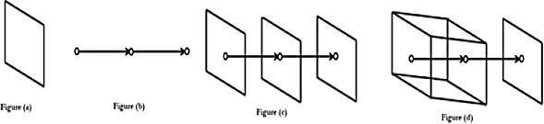
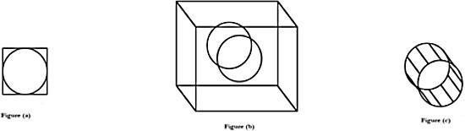
Rotational Sweep: A 2D shape is rotated around a predefined rotational axis. Example: following figure shows a rotational sweep.
Steps:
Define a shape as a polygon vertex table as shown in figure (a).
Define a sweep path as a sequence of rotations.
Rotate the shape; continue building a vertex table as shown in figure (b).
Define a surface table as shown in figure (c).

Slide 14
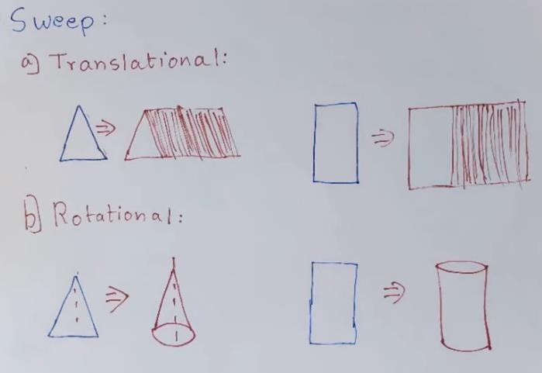

Slide 15
Constructive Solid Geometry (CSG):
A CSG model is based on the topological notion that a physical object can be divided into a set of primitives (basic elements or shapes) that can be combined in a certain order following a set of rules (Boolean operations) to form the object. Each primitive is bounded by a set of surfaces; usually closed and orientable.
It is based on the idea of providing a set of predefined object types such as cubes, cone, sphere etc.
A solid model is created by retrieving primitive solids and performing Boolean operations.
Three types of Boolean operations:
Union (join): the operation combines two volumes included in the different solids into a single solid.
Subtract (cut): the operation subtracts the volume of one solid from the other solid object.
Intersection: the operation keeps only the volume common to both solids.

Slide 16
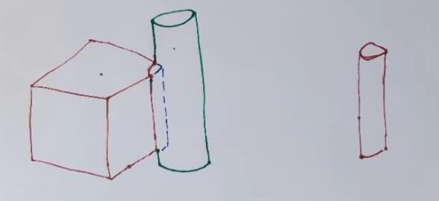

Slide 17
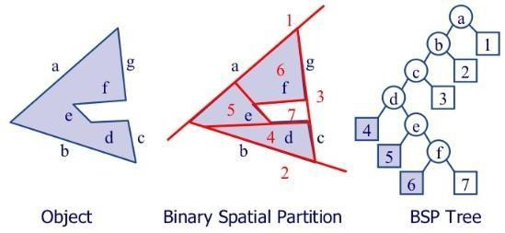
Binary space partitioning (BSP)
Binary space partitioning (BSP) is a method for space partitioning which recursively subdivides a Euclidean space into two convex sets by using hyper planes as partitions. This process of
subdividing gives rise to a representation of objects within the space in the form of a tree data structure known as a BSP tree. Euclidean space is the fundamental space of geometry, intended to represent physical space.

Slide 18
Binary space partitioning is treated as a generic process of recursively dividing a scene into two until the partitioning satisfies one or more requirements.
It can be viewed as a generalization of other spatial tree structures such as k-d trees and quadtrees, one where hyperplanes that partition space may have any orientation instead of being aligned with the coordinate axes as they are in k-d trees or quadtree.
When implemented in computer graphics to render scenes composed of planar polygons, the partitioning planes are frequently selected to coincide with the planes defined by polygons in the scene.
The specific choice of partitioning plane and criterion for completing the partitioning process varies depending on the purpose of the BSP tree.
For example: In computer graphics rendering, the scene is divided until and unless each node of the BSP tree consists of only polygons that can render in arbitrary order. When back-face culling is implemented, each node, therefore, consists of a convex set of polygons, whereas when rendering double-sided polygons, each node of the BSP tree consists of only polygons in a single plane.

Slide 19
Algorithm of generating a BSP Tree from a list of polygons
Select a polygon P from the list.
Make a node N in the BSP tree and add P to the list of polygons at that node.
For each other polygon in the list:
If that polygon is wholly in front of the plane containing P, move that polygon to the list of nodes in front of P.
If that polygon is wholly behind the plane containing P, move that polygon to the list of nodes behind P.
If that polygon is intersected by the plane containing P, split it into two polygons and move them to the respective lists of polygons behind and in front of P.
If that polygon lies in the plane containing P, add it to the list of polygons at node N.
Apply this algorithm to the list of polygons in front of P.
Apply this algorithm to the list of polygons behind P.

Slide 20
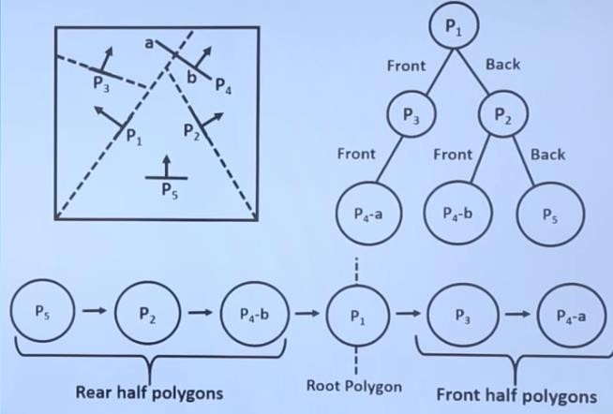

Slide 21
Disadvantage of BSP
Generating a BSP tree can be time-consuming.
BSP does not solve the problem of visible surface determination.
Uses of BSP
It is used in collision detection in 3D video games and robotics.
It is used in ray tracing
It is involved in the handling of complex spatial scenes.

Slide 22
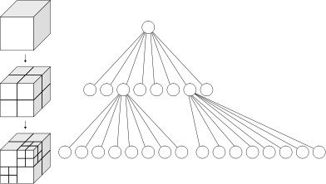
Octree Representation (Solid-object representation)
This is the space-partitioning method for 3D solid object representation. Octrees are hierarchical tree structures that describes each region space as nodes. They are used to represent solid objects in some graphics system.
Medical imaging and other applications that require displays of object cross sections commonly use octree representation. E.g. CT-scan.
Octrees are used to partition a 3D space by recursively subdividing it into eight octants. Octant subdivisions continue until the region of space contains only homogeneous octants.
Octrees are often used in 3D graphics and 3D game engines.
Fig: Left: Recursive subdivision of a cube into octants & Right: The corresponding octree

Slide 23
Advantages:
It provides a convenient representation for storing information about object interiors.
They can represent arbitrary shapes and that we can quickly analyze what is present at a specific position in space.
Disadvantages:
Imprecise representation, high storage demands and complex transformation operations.

Slide 24
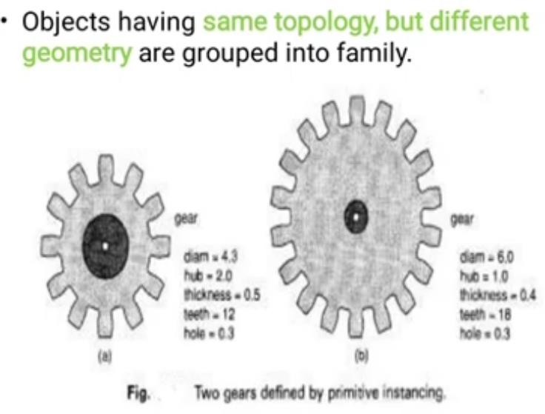
Primitive Instancing

Slide 25
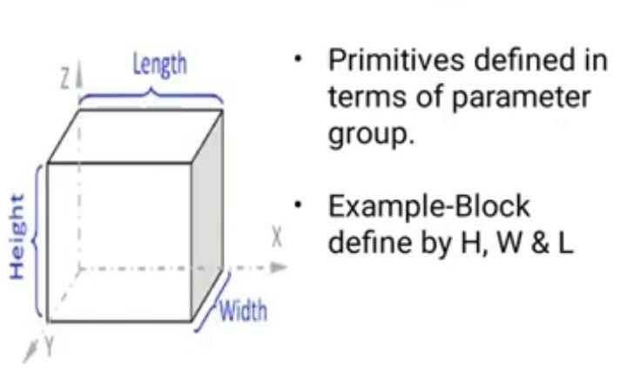

Slide 26
Thank You

